Slide 1
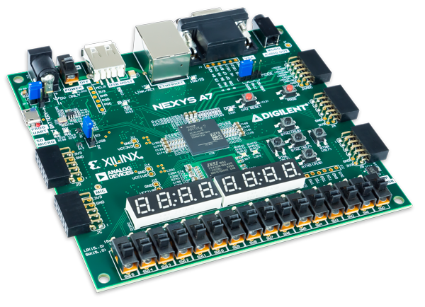
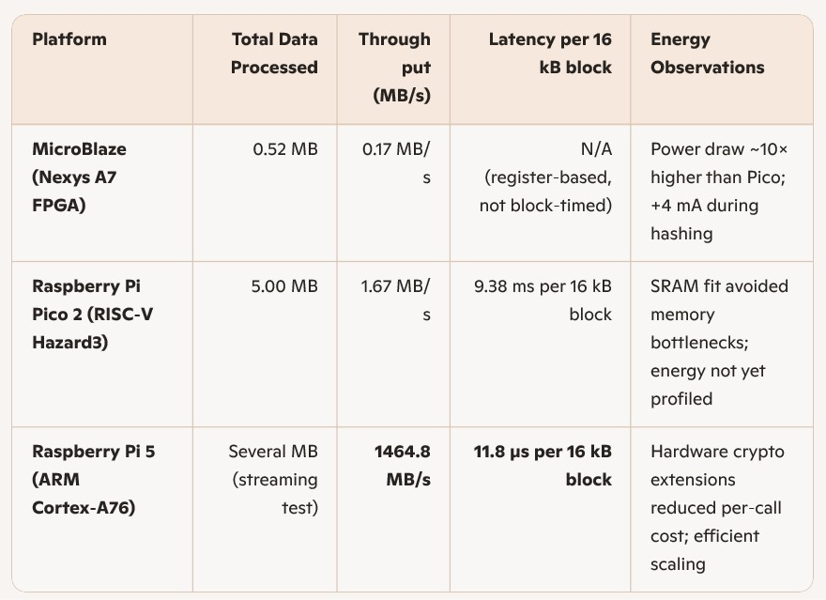
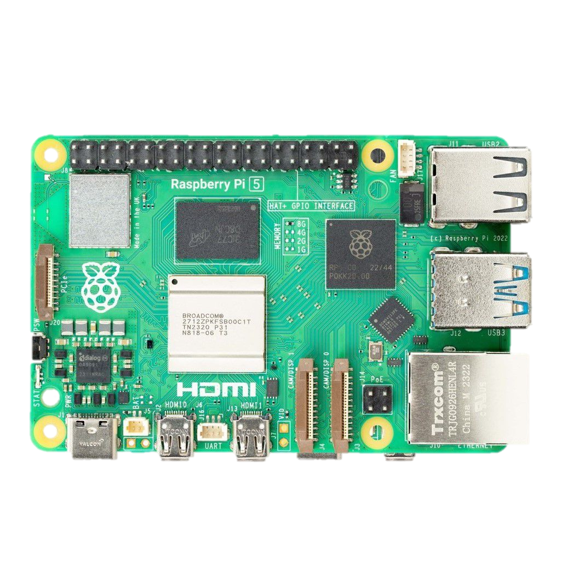
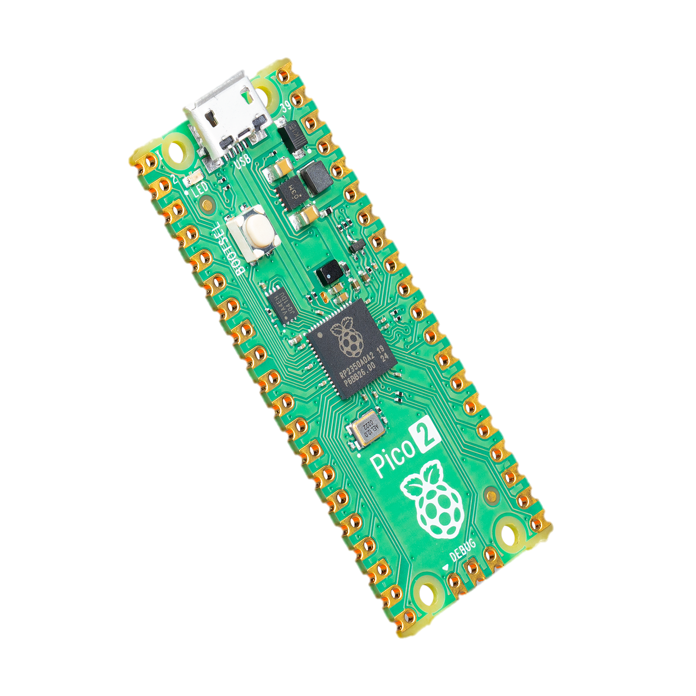
CAABSP: Computer Architectural Analysis Benchmarking Softcore Processors
ECE 4300.01 Computer Architecture Group A
Ella Shepherd, Aaron Tran, Max Gross, Anish Chinnakonda
Nexys a7
With
Microblaze
raspberry pi 5
With
Arm
Raspberry pi pico 2
With
Riscv

